Slide 1
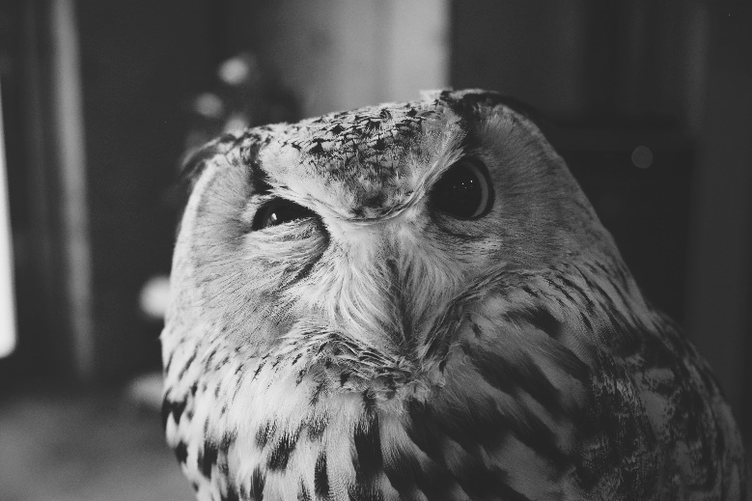
Tzu chi English Educational Qi Skills
Central points
Emotional intelligence – a combination of me and we skills;
What if skills are the combination of the Qi skills
Maximize potential, not possessions
Give all children access to a world of possibilities.
Create a word bank for discussion
Me Skills – self awareness, self control, impulse control, focus and attention (be in control of our own thoughts feelings and actions;
We Skills – People skills, relationship skills, communication, collaboration, teamwork, active listening, empathy
Why skills – Exploration; curiosity, asking questions,
Will Skills – Grit, perseverance, motivation,
Wiggle skills – Physically restless, the ability to take action ( assists thinking, creativity and innovation
Wobble – agility, adaptability, (face overcome and learn from failure);
What if – innovation, imagination, creativity, out of the box thinking,
Speaking
Being able to express your opinion
Listening
Active Listening with understanding
Creativity
Adding new thoughts to the discussion
Questions
Team Building
Asking poignant questions
Skills Fostered in this Class
Christopher Bauman – www.chrisbauman.com.au

Slide 2
1. What do you think are the most valuable skills that are going to emerge in the next 5 – 10 years?
____________________________________________________________________________________________?
Advanced Question Words
2. Creativity, Curiousity, Collaboration, Critical thinking, grit, leadership, adaptability, ___________________________________________________________________________________________ ?
Important to be able to read other people
How do you ask a good question?
3. Children’s learning potential is deeply dependent on social interactions ___________________________________________________________________________________________ ?
Kindness; care & empathy
4. Time to improvise and gain experience, permission to gain experience, willingness to learn from failures, be mentored by wise teachers ___________________________________________________________________________________________ ?
Impulse control – executive function skills
5. How do you encourage a natural sense of wonder? ___________________________________________________________________________________________ ?
Fail early, fail often and fail forward
Learn about the world by physically interacting with it.
6.Intrinsic motivation – the motivation that comes from within ___________________________________________________________________________________________ ?
Extrinsic – rewards and punishments (v) Intrinsic – self motivation
7. How do you put your wiggles to work? ___________________________________________________________________________________________ ?
Daily failure
8. When have you failed and what did you do about it? ___________________________________________________________________________________________ ?
Rewards Kill creativity
What if – imagine the world not just how it is, but how it could be.
What is your purpose? What is your passion?
Christopher Bauman – www.chrisbauman.com.au

